Slide 1
Faltende neuronale netze
Eine Präsentation von Benjamin Jank

Slide 2
Übersicht über Maschinelles Lernen
Künstliche Intelligenz
„ist ein Teilgebiet der Informatik. Sie imitiert menschliche kognitive Fähigkeiten [...]. Diese Intelligenz kann auf programmierten Abläufen basieren oder durch maschinelles Lernen erzeugt werde.“ (Frauenhofer-Institut für Kognitive Systeme IKS)
Maschinelles Lernen
„ist ein Teilbereich der künstlichen Intelligenz (KI). Der Schwerpunkt liegt auf dem Trainieren von Computern, damit diese aus Daten und Erfahrungen lernen […] – anstatt explizit dafür programmiert zu werden.“ (SAP)
Algorithmen
Maschinelles Lernen

Slide 3
Übersicht über Maschinelles Lernen
Algorithmen
Maschinelles Lernen
Input
Input
f(x)
Zustand
f(x)
Output
Output

Slide 4
Übersicht über Maschinelles Lernen
Maschinelles Lernen
Überwachtes
Lernen
Unüberwachtes
Lernen
Bestärkendes
Lernen
Klassifizierung
Regression

Slide 5
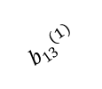
















Ein künstliches neuronales Netz
z₁⁽²⁾ a₁⁽²⁾
$${w22}^{(2)}$$
$${w11}^{(1)}$$
$${w32}^{(2)}$$
x₁
$${w21}^{(1)}$$
z₁⁽³⁾ a₁⁽³⁾
$${w31}^{(1)}$$
$${w22}^{(2)}$$
$${w12}^{(1)}$$
z₂⁽²⁾ a₂⁽²⁾
$${w32}^{(2)}$$
$${w22}^{(1)}$$
x₂
$${w32}^{(1)}$$
z₂⁽³⁾ a₂⁽³⁾
$${w22}^{(2)}$$
$${b13}^{(1)}$$
$${w32}^{(2)}$$
$${b23}^{(1)}$$
z₃⁽²⁾ a₃⁽²⁾
₁
$${b33}^{(1)}$$
$${b11}^{(2)}$$
$${b21}^{(2)}$$
₁
L1
L2
L3

Slide 6
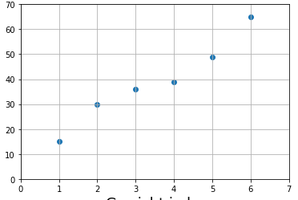
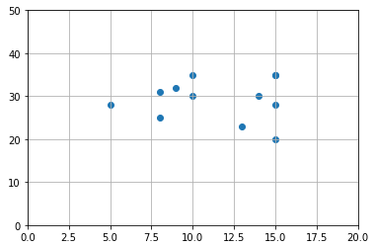
Ein künstliches neuronales Netz
Regression
Klassifizierung
mit striktem Ansatz (z.B. lineare Funktion f(x)=ax + b) Modellierung sehr eingeschränkt
Neuronale Netze: komplexe Funktion → verschachtelte Funktionen mit einer Vielzahl an Parametern ➔ jede Funktion annähernd darstellbar

Slide 7
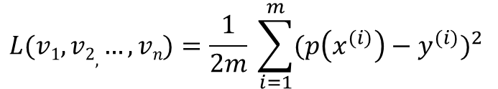
Training eines neuronalen Netzes
Die Fehlerfunktion
Parameter von Model als Eingabe
Gibt Abweichung des Models von Wahrheitswerten zurück
Mean Squared Error Funktion:
Das Gradientenverfahren
Iterativer Algorithmus, um differenzierbare Funktion zu minimieren
Hilfsmittel, um Fehlerfunktion zu optimieren
$$L(v1, v2, …, vn)=\frac{1}{2m} \sum_{i=1}^{m}{{(p\left(x^{(i)}\right)−y^{(i)})}^{2} }$$

Slide 8
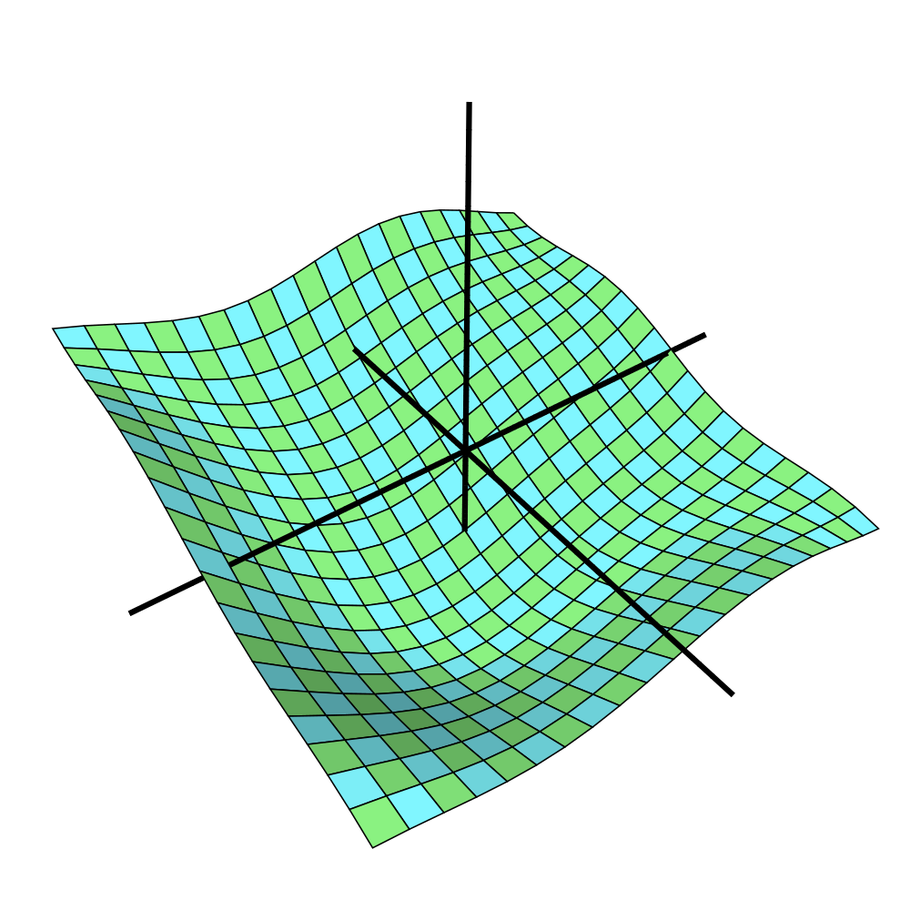
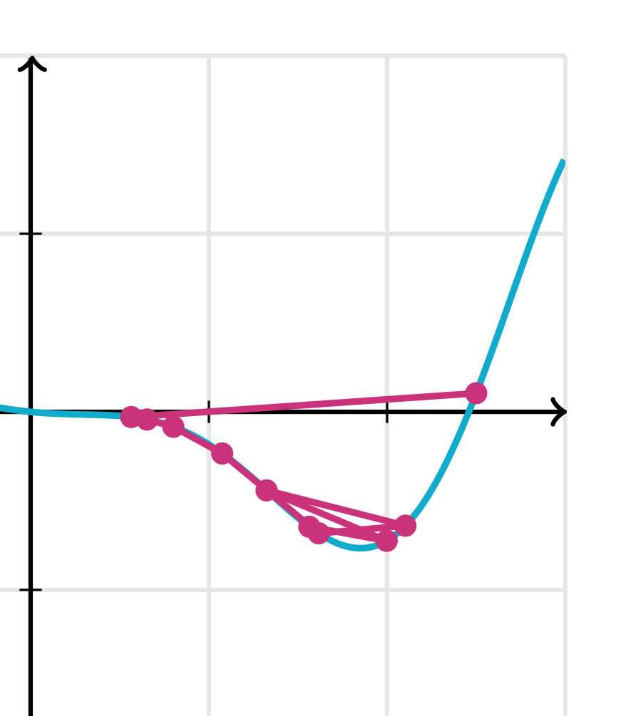

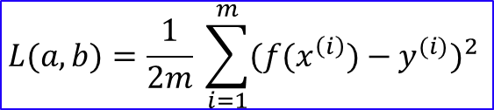



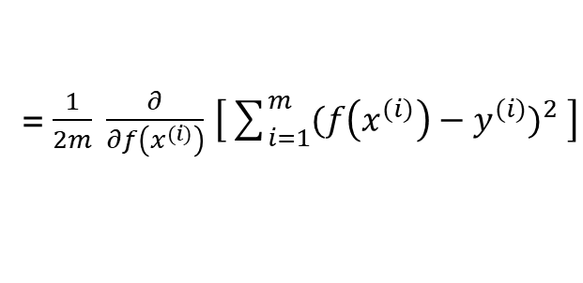
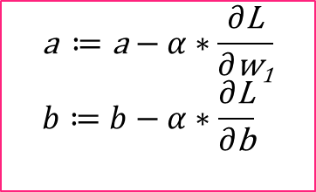

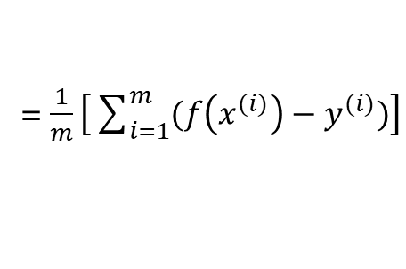
Das Gradientenverfahren
Wichtige Bezeichnungen
$$\text{a} ≔\text{a}−α∗\frac{∂\text{L}}{∂\text{w}\text{1}} \\ b≔b−α∗\frac{∂\text{L}}{∂\text{b}}$$
$$L(a, b)=\frac{1}{2m} \sum_{i=1}^{m}{{({f(x}^{\left(i\right)})−y^{(i)})}^{2} }$$
$$f\left(x\right)=ax+b$$
$\frac{∂\text{L}}{∂\text{v}}$ = $\frac{∂\text{L}}{∂f\left(x^{(i)}\right)}\frac{∂f\left(x^{(i)}\right)}{∂\text{v}}$
L
$\frac{∂\text{L}}{∂f\left(x^{(i)}\right)}$ = $\frac{∂}{∂f\left(x^{(i)}\right)}$ $\left[\frac{1}{2m}\sum_{i=1}^{m}{{(f\left(x^{(i)}\right)−y^{(i)})}^{2} }\right]$
L
= $\frac{1}{2m} \frac{∂}{∂f\left(x^{(i)}\right)}$ $\left[\sum_{i=1}^{m}{{(f\left(x^{(i)}\right)−y^{(i)})}^{2} }\right]$
= $\frac{1}{2m} \left[\sum_{i=1}^{m}{{\frac{∂}{∂f\left(x^{(i)}\right)} (f\left(x^{(i)}\right)−y^{(i)})}^{2} }\right]$
x P
= $\frac{1}{2m} \left[\sum_{i=1}^{m}{2(f\left(x^{(i)}\right)−y^{(i)})}∗\frac{∂}{∂f\left(x^{(i)}\right)} (f\left(x^{(i)}\right)−y^{(i)})\right]$
a
a
b
= $\frac{1}{2m} 2\left[\sum_{i=1}^{m}{(f\left(x^{(i)}\right)−y^{(i)})}\right]$
x P
= $\frac{1}{m}\left[\sum_{i=1}^{m}{(f\left(x^{(i)}\right)−y^{(i)})}\right]$

Slide 9
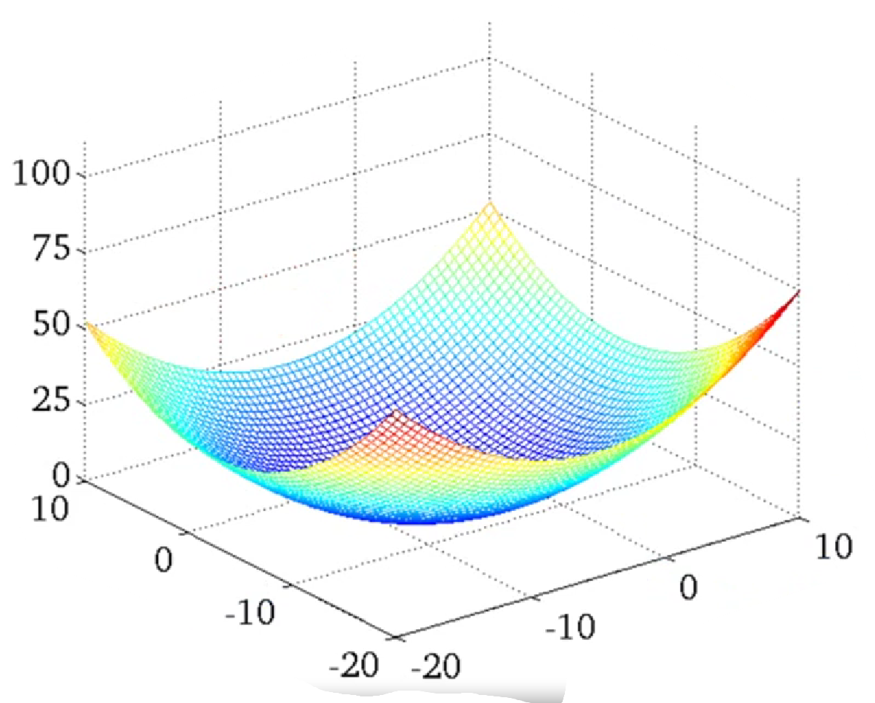
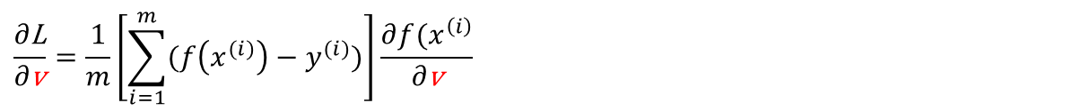
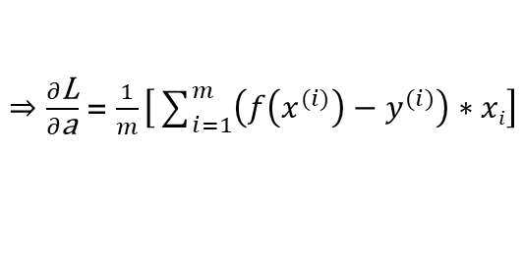
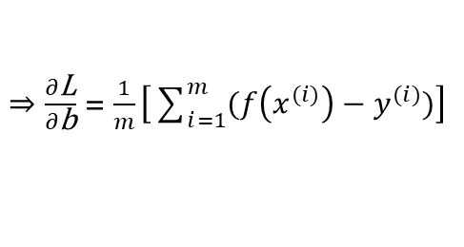
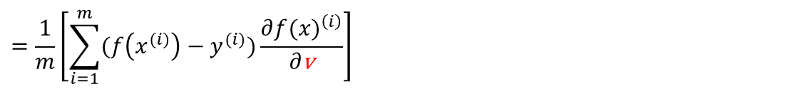
Das Gradientenverfahren
$$\text{a} ≔\text{a}−α∗\frac{∂\text{L}}{∂\text{w}\text{1}} \\ b≔b−α∗\frac{∂\text{L}}{∂\text{b}}$$
$$L(a, b)=\frac{1}{2m} \sum_{i=1}^{m}{{({f(x}^{\left(i\right)})−y^{(i)})}^{2} }$$
$$f\left(x\right)=ax+b$$
$\frac{∂\text{L}}{∂\text{v}}$ = $\frac{∂\text{L}}{∂f\left(x^{(i)}\right)}\frac{∂f\left(x^{(i)}\right)}{∂\text{v}}$
$$\frac{∂\text{L}}{∂\text{v}}=\frac{1}{m}\left[\sum_{i=1}^{m}{(f\left(x^{(i)}\right)−y^{(i)})}\right]\frac{∂{f(x}^{\left(i\right)}}{∂\text{v}}$$
$$=\frac{1}{m}\left[\sum_{i=1}^{m}{(f\left(x^{(i)}\right)−y^{(i)})}\frac{∂{f(x)}^{\left(i\right)}}{∂\text{v}}\right]$$
x P
L
$⇒\frac{∂\text{L}}{∂\text{b}}$ = $\frac{1}{m}\left[\sum_{i=1}^{m}{(f\left(x^{(i)}\right)−y^{(i)})}\right]$
$⇒\frac{∂\text{L}}{∂\text{a}}$ = $\frac{1}{m}\left[\sum_{i=1}^{m}{\left(f\left(x^{(i)}\right)−y^{(i)}\right)∗xi}\right]$
a
b

Slide 10

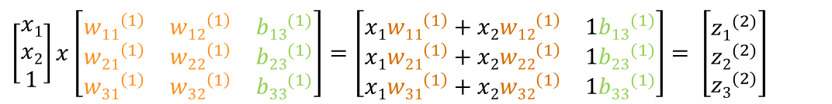

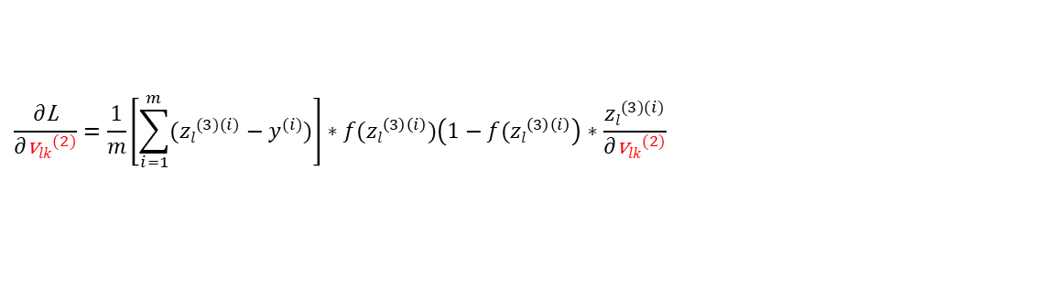
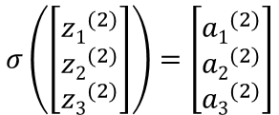
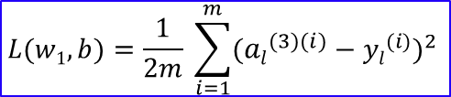
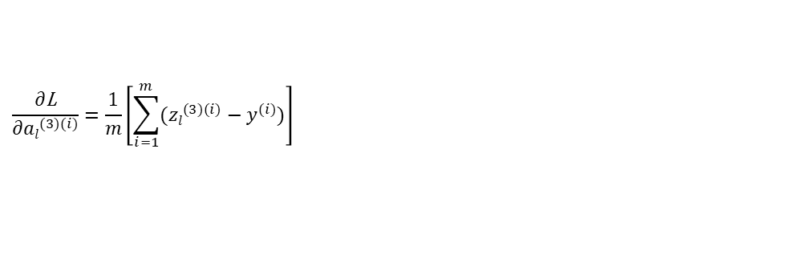

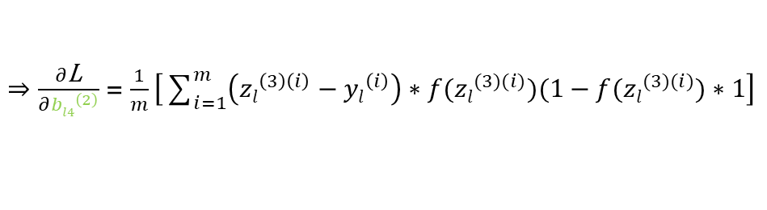
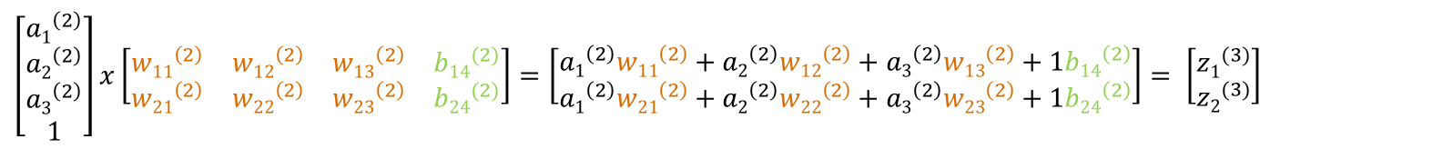
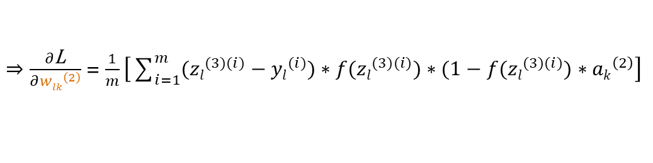

Das Multilayer Perceptron
$\left[\begin{matrix}x1 \\ x2 \\ 1\end{matrix}\right]x\left[\begin{matrix}{w11}^{\left(1\right)} & {w12}^{\left(1\right)} & {b13}^{(1)} \\ {w21}^{\left(1\right)} & {w22}^{\left(1\right)} & {b23}^{(1)} \\ {w31}^{\left(1\right)} & {w32}^{\left(1\right)} & {b33}^{(1)}\end{matrix}\right]$ $=\left[\begin{matrix}x1{w11}^{\left(1\right)}+x2{w12}^{\left(1\right)} & 1{b13}^{(1)} \\ x1{w21}^{\left(1\right)}+x2{w22}^{\left(1\right)} & 1{b23}^{(1)} \\ x1{w31}^{\left(1\right)}+x2{w32}^{\left(1\right)} & 1{b33}^{(1)}\end{matrix}\right]$ $= \left[\begin{matrix}{z1}^{(2)} \\ {z2}^{(2)} \\ {z3}^{(2)}\end{matrix}\right]$
$$σ\left(\left[\begin{matrix}{z1}^{(2)} \\ {z2}^{(2)} \\ {z3}^{(2)}\end{matrix}\right]\right)=\left[\begin{matrix}{a1}^{(2)} \\ {a2}^{(2)} \\ {a3}^{(2)}\end{matrix}\right]$$
$\left[\begin{matrix}{a1}^{\left(2\right)} \\ {a2}^{\left(2\right)} \\ {a3}^{\left(2\right)} \\ 1\end{matrix}\right]x\left[\begin{matrix}{w11}^{\left(2\right)} & {w12}^{\left(2\right)} & {w13}^{\left(2\right)} & {b14}^{(2)} \\ {w21}^{\left(2\right)} & {w22}^{\left(2\right)} & {w23}^{\left(2\right)} & {b24}^{(2)}\end{matrix}\right]=\left[\begin{matrix}{a1}^{\left(2\right)}{w11}^{\left(2\right)}+{a2}^{\left(2\right)}{w12}^{\left(2\right)}+{a3}^{\left(2\right)}{w13}^{\left(2\right)}+1{b14}^{\left(2\right)} \\ {a1}^{\left(2\right)}{w21}^{\left(2\right)}+{a2}^{\left(2\right)}{w22}^{\left(2\right)}+{a3}^{\left(2\right)}{w23}^{\left(2\right)}+1{b24}^{\left(2\right)}\end{matrix}\right]$ $= \left[\begin{matrix}{z1}^{(3)} \\ {z2}^{(3)}\end{matrix}\right]$
$$f\left(\left[\begin{matrix}{z1}^{(3)} \\ {z2}^{(3)}\end{matrix}\right]\right)=\left[\begin{matrix}{a1}^{(3)} \\ {a2}^{(3)}\end{matrix}\right]$$
$$L(w1, b)=\frac{1}{2m} \sum_{i=1}^{m}{{({al}^{(3)(i)}−{yl}^{(i)})}^{2} }$$
$${\text{w}lk}^{(2)}≔{\text{w}lk}^{(2)}−α∗\frac{∂\text{L}}{∂{\text{w}lk}^{(2)}}\text{;}{ \text{b}l4}^{(2)}≔{\text{b}l4}^{(2)}−α∗\frac{∂\text{L}}{∂{\text{b}l4}^{(2)}}$$
$\frac{∂\text{L}}{∂{\text{v}lk}^{(2)}}=\frac{∂\text{L}}{∂{al}^{(3)(i)}}\frac{∂{al}^{(3)(i)}}{∂{zl}^{(3)(i)}}$ $\frac{{zl}^{(3)(i)}}{∂{\text{v}lk}^{(2)}}$
$⇒\frac{∂\text{L}}{∂{wlk}^{\left(2\right)}}$ = $\frac{1}{m}\left[\sum_{i=1}^{m}{({zl}^{(3)(i)}−{yl}^{(i)})}∗{f(zl}^{(3)(i)})∗(1−{f(zl}^{(3)(i)})∗{ak}^{\left(2\right)}\right]$
$$\frac{∂\text{L}}{∂{al}^{(3)(i)}}=\frac{1}{m}\left[\sum_{i=1}^{m}{({zl}^{(3)(i)}−y^{(i)})}\right]$$
$⇒\frac{∂\text{L}}{∂{bl4}^{\left(2\right)}}$ = $\frac{1}{m}\left[\sum_{i=1}^{m}{\left({zl}^{\left(3\right)\left(i\right)}−{yl}^{\left(i\right)}\right)∗{f(zl}^{(3)(i)})(1−{f(zl}^{(3)(i)})}∗1\right]$
$$\frac{∂{al}^{(3)(i)}}{∂{zl}^{(3)(i)}}=\frac{∂}{∂{zl}^{(3)(i)}}{f(zl}^{(3)(i)})={f(zl}^{(3)(i)})∗(1−{f(zl}^{(3)(i)})$$
$\frac{∂{zl}^{(3)(i)}}{∂{\text{v}lk}^{(2)}}=$ $\frac{∂}{∂{\text{v}lk}^{(2)}} \left({a1}^{\left(2\right)(i)}{wl1}^{\left(2\right)}+{a2}^{\left(2\right)(i)}{wl2}^{\left(2\right)}+{a3}^{\left(2\right)(i)}{wl3}^{\left(2\right)}+1{bl4}^{\left(2\right)}\right)$
$$\frac{∂\text{L}}{∂{\text{v}lk}^{(2)}}=\frac{1}{m}\left[\sum_{i=1}^{m}{({zl}^{(3)(i)}−y^{(i)})}\right]∗{f(zl}^{\left(3\right)\left(i\right)})\left(1−{f(zl}^{\left(3\right)\left(i\right)}\right)∗\frac{{zl}^{(3)(i)}}{∂{\text{v}lk}^{(2)}}$$

Slide 11

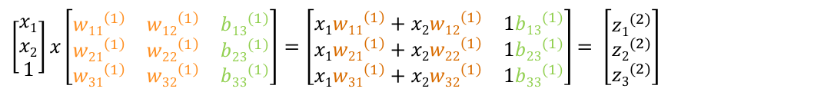




Das Multilayer Perceptron
$\left[\begin{matrix}x1 \\ x2 \\ 1\end{matrix}\right]x\left[\begin{matrix}{w11}^{\left(1\right)} & {w12}^{\left(1\right)} & {b13}^{(1)} \\ {w21}^{\left(1\right)} & {w22}^{\left(1\right)} & {b23}^{(1)} \\ {w31}^{\left(1\right)} & {w32}^{\left(1\right)} & {b33}^{(1)}\end{matrix}\right]$ $=\left[\begin{matrix}x1{w11}^{\left(1\right)}+x2{w12}^{\left(1\right)} & 1{b13}^{(1)} \\ x1{w21}^{\left(1\right)}+x2{w22}^{\left(1\right)} & 1{b23}^{(1)} \\ x1{w31}^{\left(1\right)}+x2{w32}^{\left(1\right)} & 1{b33}^{(1)}\end{matrix}\right]$ $= \left[\begin{matrix}{z1}^{(2)} \\ {z2}^{(2)} \\ {z3}^{(2)}\end{matrix}\right]$
$$σ\left(\left[\begin{matrix}{z1}^{(2)} \\ {z2}^{(2)} \\ {z3}^{(2)}\end{matrix}\right]\right)=\left[\begin{matrix}{a1}^{(2)} \\ {a2}^{(2)} \\ {a3}^{(2)}\end{matrix}\right]$$
$\left[\begin{matrix}{a1}^{\left(2\right)} \\ {a2}^{\left(2\right)} \\ {a3}^{\left(2\right)} \\ 1\end{matrix}\right]x\left[\begin{matrix}{w11}^{\left(2\right)} & {w12}^{\left(2\right)} & {w13}^{\left(2\right)} & {b14}^{(2)} \\ {w21}^{\left(2\right)} & {w22}^{\left(2\right)} & {w23}^{\left(2\right)} & {b24}^{(2)}\end{matrix}\right]=\left[\begin{matrix}{a1}^{\left(2\right)}{w11}^{\left(2\right)}+{a2}^{\left(2\right)}{w12}^{\left(2\right)}+{a3}^{\left(2\right)}{w13}^{\left(2\right)}+1{b14}^{\left(2\right)} \\ {a1}^{\left(2\right)}{w21}^{\left(2\right)}+{a2}^{\left(2\right)}{w22}^{\left(2\right)}+{a3}^{\left(2\right)}{w23}^{\left(2\right)}+1{b24}^{\left(2\right)}\end{matrix}\right]$ $= \left[\begin{matrix}{z1}^{(3)} \\ {z2}^{(3)}\end{matrix}\right]$
$$f\left(\left[\begin{matrix}{z1}^{(3)} \\ {z2}^{(3)}\end{matrix}\right]\right)=\left[\begin{matrix}{a1}^{(3)} \\ {a2}^{(3)}\end{matrix}\right]$$
$$L(w1, b)=\frac{1}{2m} \sum_{i=1}^{m}{{({al}^{(3)(i)}−{yl}^{(i)})}^{2} }$$
$${\text{w}kj}^{(1)}≔{\text{w}kj}^{(1)}−α∗\frac{∂\text{L}}{∂{\text{w}kj}^{(1)}}\text{;}{ \text{b}k3}^{(1)}≔{ \text{b}k3}^{(1)}−α∗\frac{∂\text{L}}{{ \text{b}k3}^{(1)}}$$
$$\frac{∂\text{L}}{∂{\text{v}kj}^{(1)}}=\frac{∂\text{L}}{∂{al}^{(3)(i)}}\frac{∂{al}^{(3)(i)}}{∂{zl}^{(3)(i)}}\frac{∂{zl}^{(3)(i)}}{∂{ak}^{(2)(i)}}\frac{∂{ak}^{(2)(i)}}{∂{zk}^{\left(2\right)\left(i\right)}}\frac{{∂zk}^{\left(2\right)\left(i\right)}}{∂{\text{v}kj}^{(1)}}$$
$$\frac{{∂zl}^{(3)(i)}}{∂{ak}^{(2)(i)}}=\frac{∂}{∂{ak}^{(2)(i)}}\left({a1}^{\left(2\right)(i)}{wl1}^{\left(2\right)}+{a2}^{\left(2\right)(i)}{wl2}^{\left(2\right)}+{a3}^{\left(2\right)(i)}{wl3}^{\left(2\right)}+1{bl4}^{\left(2\right)}\right)={wlk}^{(2)}$$
$$\frac{∂{ak}^{(2)(i)}}{∂{zk}^{\left(2\right)\left(i\right)}}=\frac{∂}{{∂zk}^{\left(2\right)\left(i\right)}}σ({zk}^{\left(2\right)\left(i\right)})=σ\left({zk}^{\left(2\right)\left(i\right)}\right)∗\left(1−σ\left({zk}^{\left(2\right)\left(i\right)}\right)\right)$$
$$\frac{{∂zk}^{\left(2\right)\left(i\right)}}{∂{\text{v}kj}^{(1)}}=\frac{∂}{∂{\text{v}kj}^{(1)}}\left(x1{wk1}^{\left(1\right)}+x2{wk2}^{\left(1\right)}+1{bk4}^{\left(1\right)}\right)$$
$$\frac{∂\text{L}}{∂{\text{v}kj}^{(1)}}=\frac{1}{m}\left[\sum_{i=1}^{m}{({zl}^{(3)(i)}−y^{(i)})}\right]∗{f(zl}^{(3)(i)})\left(1−{f(zl}^{\left(3\right)\left(i\right)}\right)∗{wlk}^{\left(2\right)}∗σ\left({zk}^{\left(2\right)\left(i\right)}\right)\left(1−σ\left({zk}^{\left(2\right)\left(i\right)}\right)\right)∗\frac{∂}{∂{\text{v}kj}^{(1)}}\left(x1{wk1}^{\left(1\right)}+x2{wk2}^{\left(1\right)}+1{bk4}^{\left(1\right)}\right)$$

Slide 12
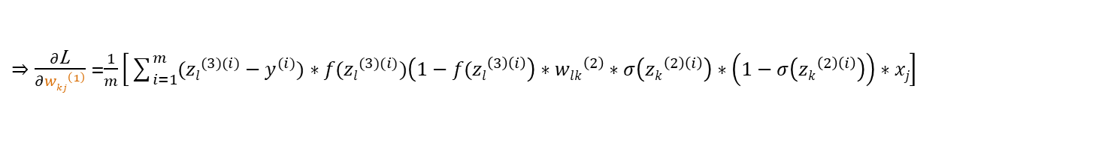
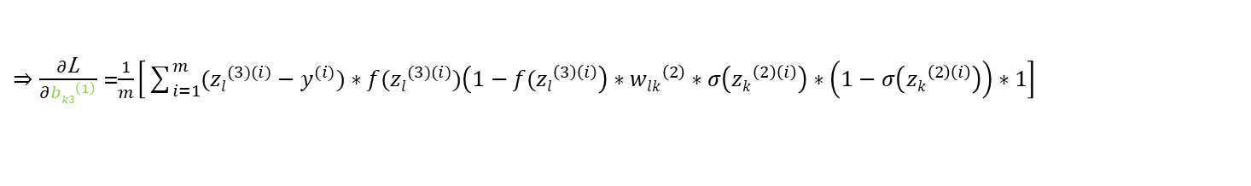
Das Multilayer Perceptron
$\left[\begin{matrix}x1 \\ x2 \\ 1\end{matrix}\right]x\left[\begin{matrix}{w11}^{\left(1\right)} & {w12}^{\left(1\right)} & {b13}^{(1)} \\ {w21}^{\left(1\right)} & {w22}^{\left(1\right)} & {b23}^{(1)} \\ {w31}^{\left(1\right)} & {w32}^{\left(1\right)} & {b33}^{(1)}\end{matrix}\right]$ $=\left[\begin{matrix}x1{w11}^{\left(1\right)}+x2{w12}^{\left(1\right)} & 1{b13}^{(1)} \\ x1{w21}^{\left(1\right)}+x2{w22}^{\left(1\right)} & 1{b23}^{(1)} \\ x1{w31}^{\left(1\right)}+x2{w32}^{\left(1\right)} & 1{b33}^{(1)}\end{matrix}\right]$ $= \left[\begin{matrix}{z1}^{(2)} \\ {z2}^{(2)} \\ {z3}^{(2)}\end{matrix}\right]$
$$σ\left(\left[\begin{matrix}{z1}^{(2)} \\ {z2}^{(2)} \\ {z3}^{(2)}\end{matrix}\right]\right)=\left[\begin{matrix}{a1}^{(2)} \\ {a2}^{(2)} \\ {a3}^{(2)}\end{matrix}\right]$$
$\left[\begin{matrix}{a1}^{\left(2\right)} \\ {a2}^{\left(2\right)} \\ {a3}^{\left(2\right)} \\ 1\end{matrix}\right]x\left[\begin{matrix}{w11}^{\left(2\right)} & {w12}^{\left(2\right)} & {w13}^{\left(2\right)} & {b14}^{(2)} \\ {w21}^{\left(2\right)} & {w22}^{\left(2\right)} & {w23}^{\left(2\right)} & {b24}^{(2)}\end{matrix}\right]=\left[\begin{matrix}{a1}^{\left(2\right)}{w11}^{\left(2\right)}+{a2}^{\left(2\right)}{w12}^{\left(2\right)}+{a3}^{\left(2\right)}{w13}^{\left(2\right)}+1{b14}^{\left(2\right)} \\ {a1}^{\left(2\right)}{w21}^{\left(2\right)}+{a2}^{\left(2\right)}{w22}^{\left(2\right)}+{a3}^{\left(2\right)}{w23}^{\left(2\right)}+1{b24}^{\left(2\right)}\end{matrix}\right]$ $= \left[\begin{matrix}{z1}^{(3)} \\ {z2}^{(3)}\end{matrix}\right]$
$$f\left(\left[\begin{matrix}{z1}^{(3)} \\ {z2}^{(3)}\end{matrix}\right]\right)=\left[\begin{matrix}{a1}^{(3)} \\ {a2}^{(3)}\end{matrix}\right]$$
$$L(w1, b)=\frac{1}{2m} \sum_{i=1}^{m}{{({al}^{(3)(i)}−{yl}^{(i)})}^{2} }$$
$${\text{w}kj}^{(1)}≔{\text{w}kj}^{(1)}−α∗\frac{∂\text{L}}{∂{\text{w}kj}^{(1)}}\text{;}{ \text{b}k3}^{(1)}≔{ \text{b}k3}^{(1)}−α∗\frac{∂\text{L}}{{ \text{b}k3}^{(1)}}$$
$$\frac{∂\text{L}}{∂{\text{v}kj}^{(1)}}=\frac{1}{m}\left[\sum_{i=1}^{m}{({zl}^{(3)(i)}−y^{(i)})}\right]∗{f(zl}^{(3)(i)})\left(1−{f(zl}^{\left(3\right)\left(i\right)}\right)∗{wlk}^{\left(2\right)}∗σ\left({zk}^{\left(2\right)\left(i\right)}\right)\left(1−σ\left({zk}^{\left(2\right)\left(i\right)}\right)\right)∗\frac{∂}{∂{\text{v}kj}^{(1)}}\left(x1{wk1}^{\left(1\right)}+x2{wk2}^{\left(1\right)}+1{bk4}^{\left(1\right)}\right)$$
$⇒\frac{∂\text{L}}{∂{wkj}^{\left(1\right)}}$ =$\frac{1}{m}\left[\sum_{i=1}^{m}{({zl}^{(3)(i)}−y^{(i)}){∗f(zl}^{(3)(i)})\left(1−{f(zl}^{\left(3\right)\left(i\right)}\right)}∗{wlk}^{\left(2\right)}∗σ\left({zk}^{\left(2\right)\left(i\right)}\right)∗\left(1−σ\left({zk}^{\left(2\right)\left(i\right)}\right)\right)∗xj\right]$
$⇒\frac{∂\text{L}}{∂{bk3}^{\left(1\right)}}$ =$\frac{1}{m}\left[\sum_{i=1}^{m}{({zl}^{(3)(i)}−y^{(i)})}{∗f(zl}^{(3)(i)})\left(1−{f(zl}^{\left(3\right)\left(i\right)}\right)∗{wlk}^{\left(2\right)}∗σ\left({zk}^{\left(2\right)\left(i\right)}\right)∗\left(1−σ\left({zk}^{\left(2\right)\left(i\right)}\right)\right)∗1\right]$

Slide 13

















Das Multilayer Perceptron
z₁⁽²⁾ a₁⁽²⁾
$${w22}^{(2)}$$
$${w11}^{(1)}$$
$${w32}^{(2)}$$
x₁
$${w21}^{(1)}$$
z₁⁽³⁾ a₁⁽³⁾
$${w31}^{(1)}$$
$${w22}^{(2)}$$
$${w12}^{(1)}$$
z₂⁽²⁾ a₂⁽²⁾
$${w32}^{(2)}$$
flatten
x₂
$${w22}^{(1)}$$
$${w32}^{(1)}$$
z₂⁽³⁾ a₂⁽³⁾
$${w22}^{(2)}$$
$${b13}^{(1)}$$
$${w32}^{(2)}$$
$${b23}^{(1)}$$
z₃⁽²⁾ a₃⁽²⁾
₁
$${b33}^{(1)}$$
$${b11}^{(2)}$$
$${b21}^{(2)}$$
₁
1. faltende
Schicht
2. faltende
Schicht

Slide 14
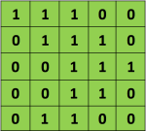
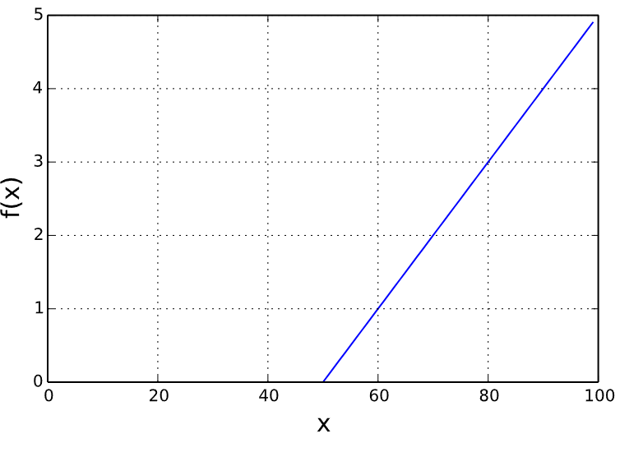





Die faltende Schicht
$$\left[\begin{matrix}12 & 9 & 12 \\ 6 & 12 & 9 \\ 6 & 9 & 12\end{matrix}\right]$$
$$f\left(\left[\begin{matrix}12 & 9 & 12 \\ 6 & 12 & 9 \\ 6 & 9 & 12\end{matrix}\right]\right)$$
$$\left[\begin{matrix}12 & 9 & 12 \\ 6 & 12 & 9 \\ 6 & 9 & 12\end{matrix}\right]$$
$$\left[\begin{matrix}12 & 12 \\ 12 & 12\end{matrix}\right]$$
Dimensionen von Fenster: 2x2
→ Max-Pooling
→ Durchschnitt-Pooling
Faltungs-Schritt (Convolution) → Parameter: Stride, Kernel, Kernel-Dimensionen, Anzahl Kernel
Aktivierungsfunktion → Parameter: -
Pooling → Parameter: Stride, Kernel-Dimensionen

Slide 15

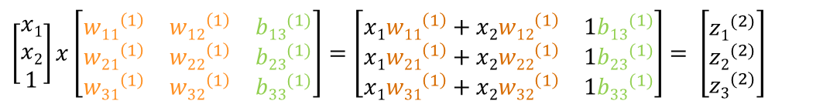

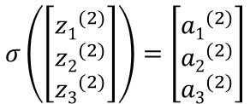

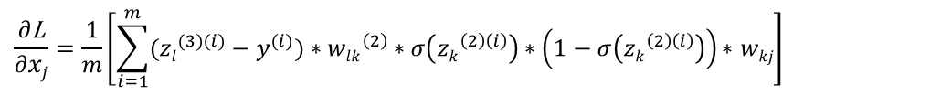

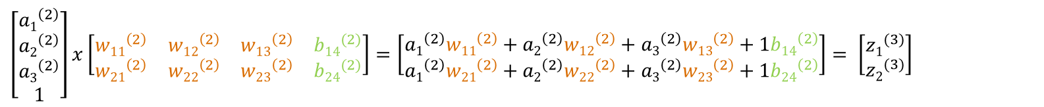
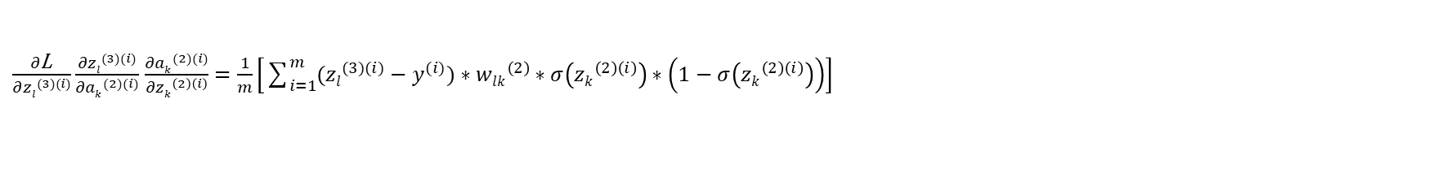
Das Multilayer Perceptron
C1
C2
$\left[\begin{matrix}x1 \\ x2 \\ 1\end{matrix}\right]x\left[\begin{matrix}{w11}^{\left(1\right)} & {w12}^{\left(1\right)} & {b13}^{(1)} \\ {w21}^{\left(1\right)} & {w22}^{\left(1\right)} & {b23}^{(1)} \\ {w31}^{\left(1\right)} & {w32}^{\left(1\right)} & {b33}^{(1)}\end{matrix}\right]$ $=\left[\begin{matrix}x1{w11}^{\left(1\right)}+x2{w12}^{\left(1\right)} & 1{b13}^{(1)} \\ x1{w21}^{\left(1\right)}+x2{w22}^{\left(1\right)} & 1{b23}^{(1)} \\ x1{w31}^{\left(1\right)}+x2{w32}^{\left(1\right)} & 1{b33}^{(1)}\end{matrix}\right]$ $= \left[\begin{matrix}{z1}^{(2)} \\ {z2}^{(2)} \\ {z3}^{(2)}\end{matrix}\right]$
$$σ\left(\left[\begin{matrix}{z1}^{(2)} \\ {z2}^{(2)} \\ {z3}^{(2)}\end{matrix}\right]\right)=\left[\begin{matrix}{a1}^{(2)} \\ {a2}^{(2)} \\ {a3}^{(2)}\end{matrix}\right]$$
$\left[\begin{matrix}{a1}^{\left(2\right)} \\ {a2}^{\left(2\right)} \\ {a3}^{\left(2\right)} \\ 1\end{matrix}\right]x\left[\begin{matrix}{w11}^{\left(2\right)} & {w12}^{\left(2\right)} & {w13}^{\left(2\right)} & {b14}^{(2)} \\ {w21}^{\left(2\right)} & {w22}^{\left(2\right)} & {w23}^{\left(2\right)} & {b24}^{(2)}\end{matrix}\right]=\left[\begin{matrix}{a1}^{\left(2\right)}{w11}^{\left(2\right)}+{a2}^{\left(2\right)}{w12}^{\left(2\right)}+{a3}^{\left(2\right)}{w13}^{\left(2\right)}+1{b14}^{\left(2\right)} \\ {a1}^{\left(2\right)}{w21}^{\left(2\right)}+{a2}^{\left(2\right)}{w22}^{\left(2\right)}+{a3}^{\left(2\right)}{w23}^{\left(2\right)}+1{b24}^{\left(2\right)}\end{matrix}\right]$ $= \left[\begin{matrix}{z1}^{(3)} \\ {z2}^{(3)}\end{matrix}\right]$
$$f\left(\left[\begin{matrix}{z1}^{(3)} \\ {z2}^{(3)}\end{matrix}\right]\right)=\left[\begin{matrix}{a1}^{(3)} \\ {a2}^{(3)}\end{matrix}\right]$$
$$L(w1, b)=\frac{1}{2m} \sum_{i=1}^{m}{{({zl}^{(3)(i)}−{yl}^{(i)})}^{2} }$$
$${\text{w}ih}^{(0)}≔{\text{w}ih}^{(0)}−α∗\frac{∂\text{L}}{∂{\text{w}ih}^{(0)}}$$
$\frac{∂\text{L}}{∂{\text{w}ih}^{(0)}}=\frac{∂\text{L}}{∂{zl}^{(3)(i)}}\frac{{∂zl}^{(3)(i)}}{∂{ak}^{(2)(i)}}$ $\frac{∂{ak}^{(2)(i)}}{∂{zk}^{\left(2\right)\left(i\right)}}\frac{{∂zk}^{\left(2\right)\left(i\right)}}{∂xj}\frac{∂xj}{{\text{w}ih}^{(0)}}$
$\frac{∂\text{L}}{∂{zl}^{(3)(i)}}\frac{{∂zl}^{(3)(i)}}{∂{ak}^{(2)(i)}}$ $\frac{∂{ak}^{(2)(i)}}{∂{zk}^{\left(2\right)\left(i\right)}}=\frac{1}{m}\left[\sum_{i=1}^{m}{({zl}^{(3)(i)}−y^{(i)})}∗{wlk}^{\left(2\right)}∗σ\left({zk}^{\left(2\right)\left(i\right)}\right)∗\left(1−σ\left({zk}^{\left(2\right)\left(i\right)}\right)\right)\right]$
$$\frac{{∂zk}^{\left(2\right)\left(i\right)}}{∂xj}=\frac{∂}{∂xj}\left(x1{wk1}^{\left(1\right)}+x2{wk2}^{\left(1\right)}+1{bk4}^{\left(1\right)}\right)=wkj$$
$$\frac{∂\text{L}}{∂xj}=\frac{1}{m}\left[\sum_{i=1}^{m}{({zl}^{(3)(i)}−y^{(i)})}∗{wlk}^{\left(2\right)}∗σ\left({zk}^{\left(2\right)\left(i\right)}\right)∗\left(1−σ\left({zk}^{\left(2\right)\left(i\right)}\right)\right)\text{∗ }wkj\right]$$

Slide 16









































Das Multilayer Perceptron
C1
C2
$\left[\begin{matrix}x1 \\ x2 \\ 1\end{matrix}\right]x\left[\begin{matrix}{w11}^{\left(1\right)} & {w12}^{\left(1\right)} & {b13}^{(1)} \\ {w21}^{\left(1\right)} & {w22}^{\left(1\right)} & {b23}^{(1)} \\ {w31}^{\left(1\right)} & {w32}^{\left(1\right)} & {b33}^{(1)}\end{matrix}\right]$ $=\left[\begin{matrix}x1{w11}^{\left(1\right)}+x2{w12}^{\left(1\right)} & 1{b13}^{(1)} \\ x1{w21}^{\left(1\right)}+x2{w22}^{\left(1\right)} & 1{b23}^{(1)} \\ x1{w31}^{\left(1\right)}+x2{w32}^{\left(1\right)} & 1{b33}^{(1)}\end{matrix}\right]$ $= \left[\begin{matrix}{z1}^{(2)} \\ {z2}^{(2)} \\ {z3}^{(2)}\end{matrix}\right]$
$$σ\left(\left[\begin{matrix}{z1}^{(2)} \\ {z2}^{(2)} \\ {z3}^{(2)}\end{matrix}\right]\right)=\left[\begin{matrix}{a1}^{(2)} \\ {a2}^{(2)} \\ {a3}^{(2)}\end{matrix}\right]$$
$\left[\begin{matrix}{a1}^{\left(2\right)} \\ {a2}^{\left(2\right)} \\ {a3}^{\left(2\right)} \\ 1\end{matrix}\right]x\left[\begin{matrix}{w11}^{\left(2\right)} & {w12}^{\left(2\right)} & {w13}^{\left(2\right)} & {b14}^{(2)} \\ {w21}^{\left(2\right)} & {w22}^{\left(2\right)} & {w23}^{\left(2\right)} & {b24}^{(2)}\end{matrix}\right]=\left[\begin{matrix}{a1}^{\left(2\right)}{w11}^{\left(2\right)}+{a2}^{\left(2\right)}{w12}^{\left(2\right)}+{a3}^{\left(2\right)}{w13}^{\left(2\right)}+1{b14}^{\left(2\right)} \\ {a1}^{\left(2\right)}{w21}^{\left(2\right)}+{a2}^{\left(2\right)}{w22}^{\left(2\right)}+{a3}^{\left(2\right)}{w23}^{\left(2\right)}+1{b24}^{\left(2\right)}\end{matrix}\right]$ $= \left[\begin{matrix}{z1}^{(3)} \\ {z2}^{(3)}\end{matrix}\right]$
$$f\left(\left[\begin{matrix}{z1}^{(3)} \\ {z2}^{(3)}\end{matrix}\right]\right)=\left[\begin{matrix}{a1}^{(3)} \\ {a2}^{(3)}\end{matrix}\right]$$
$$L(w1, b)=\frac{1}{2m} \sum_{i=1}^{m}{{({zl}^{(3)(i)}−{yl}^{(i)})}^{2} }$$
$$\frac{∂\text{L}}{∂x11}$$
$$0$$
$$\frac{∂\text{L}}{∂x12}$$
$${\text{w}11}^{(0)}$$
$${\text{w}12}^{(0)}$$
$$x11$$
$$x12$$
$$x13$$
$$x14$$
$$0$$
$$0$$
$$0$$
$${\text{w}21}^{(0)}$$
$${\text{w}22}^{(0)}$$
$$x21$$
$$x22$$
$$x23$$
$$x24$$
$$\frac{∂\text{L}}{∂{\text{w}ih}^{(0)}}=\frac{∂\text{L}}{∂xj}\frac{∂xj}{{\text{w}ih}^{(0)}}$$
$$\frac{∂\text{L}}{∂x21}$$
$$0$$
$$0$$
$$x31$$
$$x32$$
$$x33$$
$$x34$$
$${\text{w}11}^{(0)}$$
$${\text{w}12}^{(0)}$$
$$\frac{∂\text{L}}{∂x11}$$
$$0$$
$$\frac{∂\text{L}}{∂x12}$$
$$x41$$
$$x42$$
$$x43$$
$$x44$$
$${\text{w}21}^{(0)}$$
$${\text{w}22}^{(0)}$$
$$\frac{∂\text{L}}{∂x1}$$
$$\frac{∂\text{L}}{∂x11}$$
$$0$$
$$\frac{∂\text{L}}{∂x12}$$
$$0$$
$$0$$
$$0$$
$$\frac{∂\text{L}}{∂x2}$$
$$\frac{∂\text{L}}{∂x11}$$
$$\frac{∂\text{L}}{∂x12}$$
$$0$$
$$0$$
$$0$$
$$\frac{∂\text{L}}{∂x21}$$
$$0$$
$$0$$
$$\frac{∂\text{L}}{∂x3}$$
$$\frac{∂\text{L}}{∂x21}$$
$$\frac{∂\text{L}}{∂x22}$$
$$\frac{∂\text{L}}{∂x21}$$
$$\frac{∂\text{L}}{∂x22}$$
$$0$$
- Summe für 1 w: 3x3 gradient
$$\frac{∂\text{L}}{∂x4}$$

Slide 17
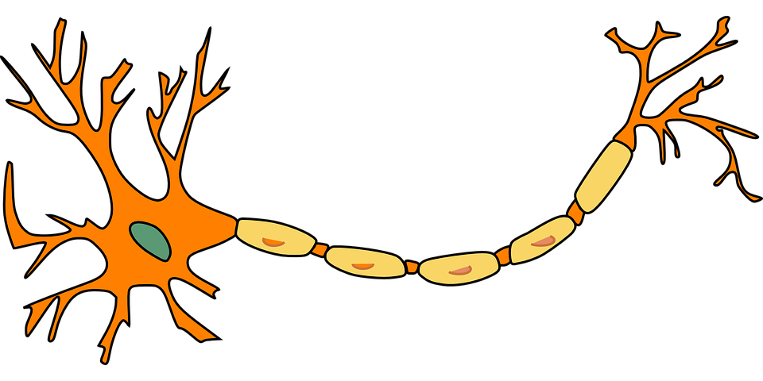
Funktionsweise faltender neuronaler Netze

Slide 18
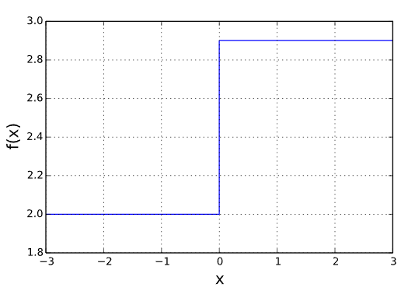
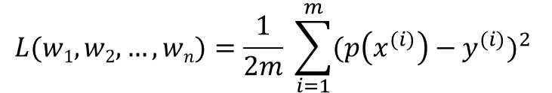
Das Single Layer Perceptron
p(x)
Die Fehlerfunktion
Parameter von Model als Eingabe
Gibt Abweichung des Models von Wahrheitswerten zurück
Mean Squared Error Funktion:
w₁
z = X₁*w₁ + X₂*w₂ + … + X_{n}*w_{n}
Y = f(z)
X₁
w₂
X₂
Y
…
$$L(w1, w2, …, wn)=\frac{1}{2m} \sum_{i=1}^{m}{{(p\left(x^{(i)}\right)−y^{(i)})}^{2} }$$
w_{n}
X_{n}

Slide 19
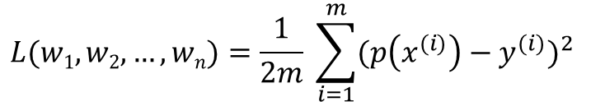
Das Single Layer Perceptron
p(x)
$$L(w1, w2, …, wn)=\frac{1}{2m} \sum_{i=1}^{m}{{(p\left(x^{(i)}\right)−y^{(i)})}^{2} }$$
w₁
z = X₁*w₁ + X₂*w₂ + … + X_{n}*w_{n}
Y = f(z)
Das Gradientenverfahren
Iterativer Algorithmus, um differenzierbare Funktion zu minimieren
Hilfsmittel, um Fehlerfunktion zu optimieren
X₁
w₂
X₂
Y
…
w_{n}
X_{n}

Slide 20
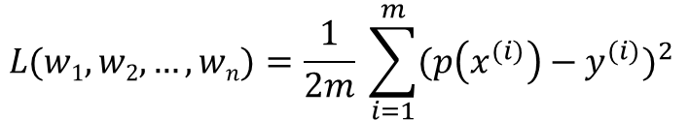
Das Single Layer Perceptron
p(x)
$$L(w1, w2, …, wn)=\frac{1}{2m} \sum_{i=1}^{m}{{(p\left(x^{(i)}\right)−y^{(i)})}^{2} }$$
w₁
z = X₁*w₁ + X₂*w₂ + … + X_{n}*w_{n}
Y = z
Das Gradientenverfahren
Iterativer Algorithmus, um differenzierbare Funktion zu minimieren
Hilfsmittel, um Fehlerfunktion zu optimieren
X₁
w₂
X₂
Y
…
w_{n}
X_{n}

Slide 21
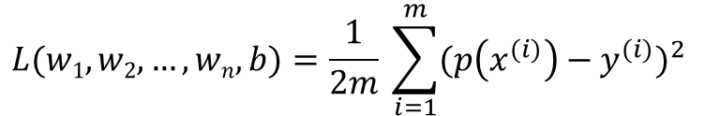
Das Single Layer Perceptron
p(x)
$$L(w1, w2, …, wn,b)=\frac{1}{2m} \sum_{i=1}^{m}{{(p\left(x^{(i)}\right)−y^{(i)})}^{2} }$$
w₁
z = X₁*w₁ + X₂*w₂ + … + X_{n}*w_{n} + b
Y = z
Das Gradientenverfahren
Iterativer Algorithmus, um differenzierbare Funktion zu minimieren
Hilfsmittel, um Fehlerfunktion zu optimieren
X₁
w₂
X₂
Y
…
w_{n}
X_{n}
b

Slide 22
Das Single Layer Perceptron
p(x)
w₁
z = X₁*w₁ + X₂*w₂ + … + X_{n}*w_{n} + b
Y = z
X₁
w₂
X₂
Y
…
w_{n}
X_{n}
b
1

Slide 23
Das Single Layer Perceptron
p(x)
w₁
z = X₁*w₁ + X₂*w₂ + … + X_{n}*w_{n} + b
Y = f(z)
X₁
w₂
X₂
Y
…
w_{n}
X_{n}
b
1

